Slide 1
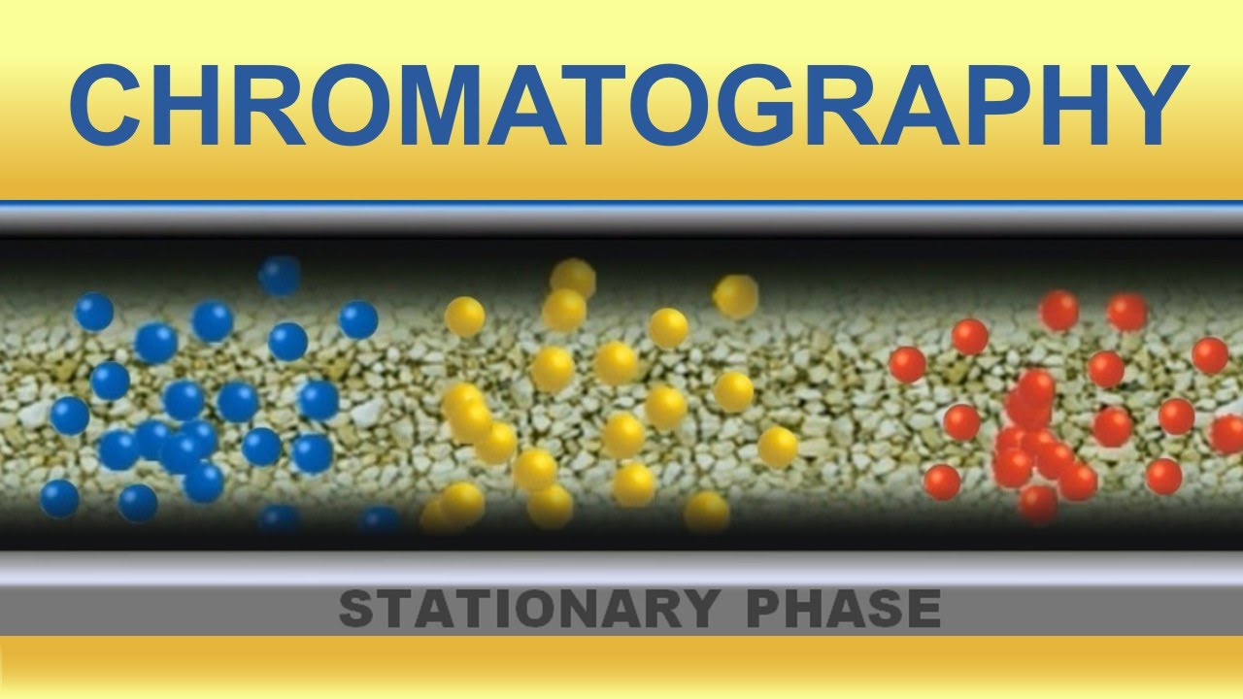

Slide 2
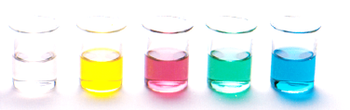
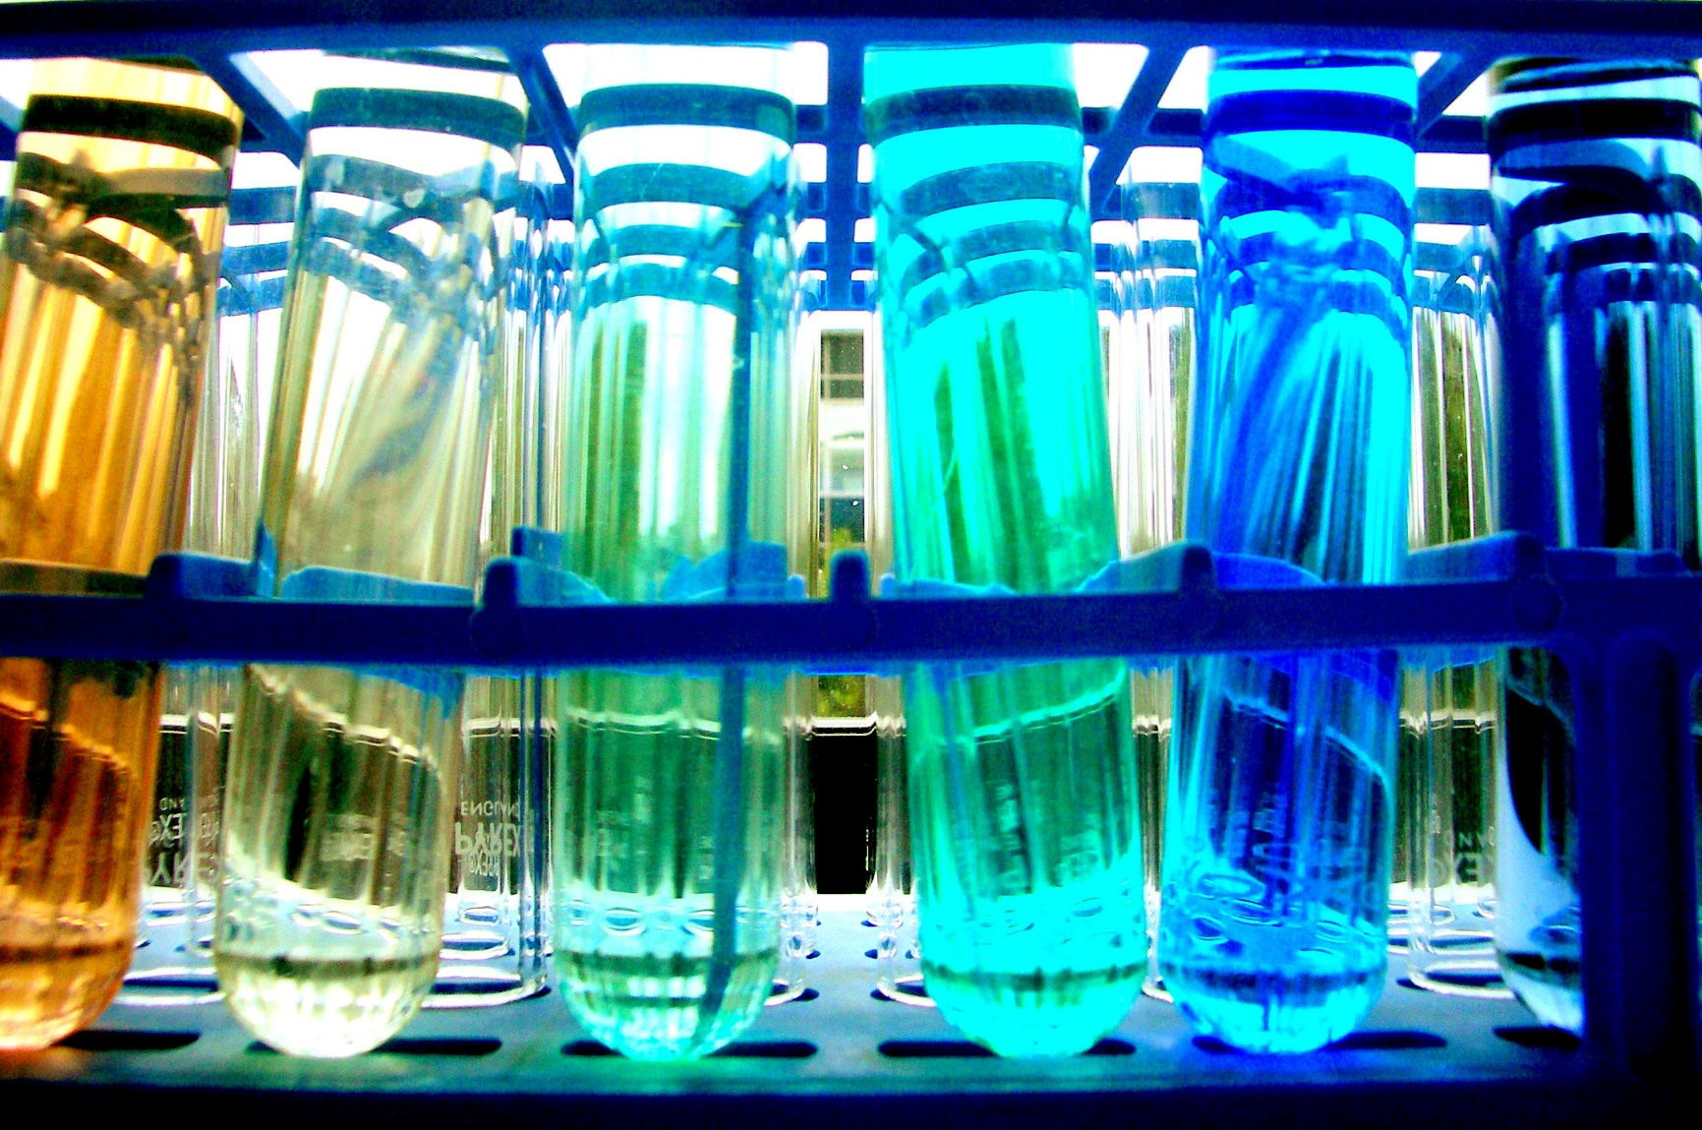
Chromatography
Derived from the Greek word Chroma meaning colour, chromatography provides a way to identify unknown compounds and separate mixtures

Slide 3
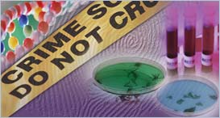
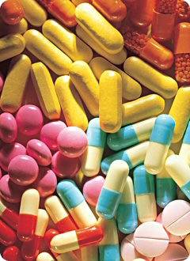
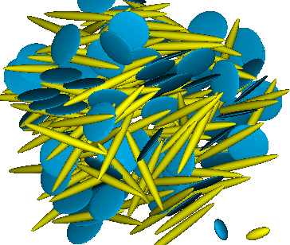
Chromatography
Chromatography is a technique for
separating mixtures of compounds
identifying unknown compounds
establishing the purity or concentration of compounds
monitoring product formation in the pharmaceutical and biotechnology industries
Forensics
Pharmaceutical industry
Research

Slide 4
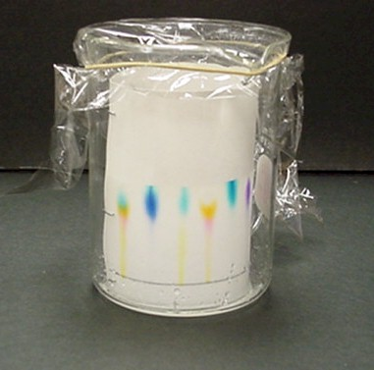
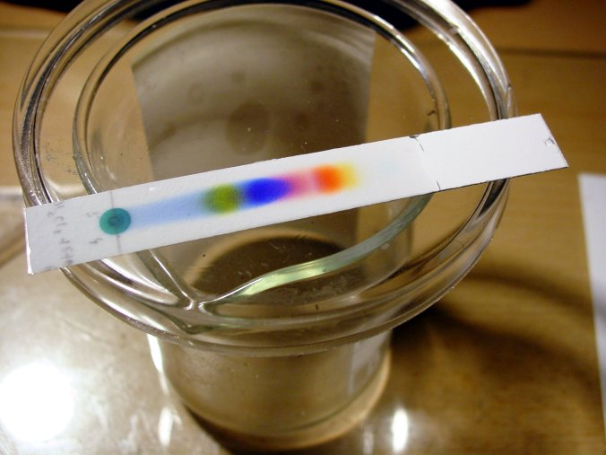

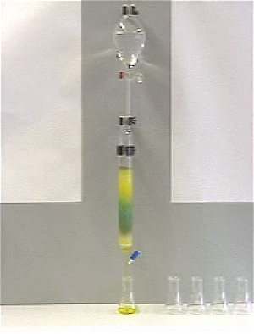
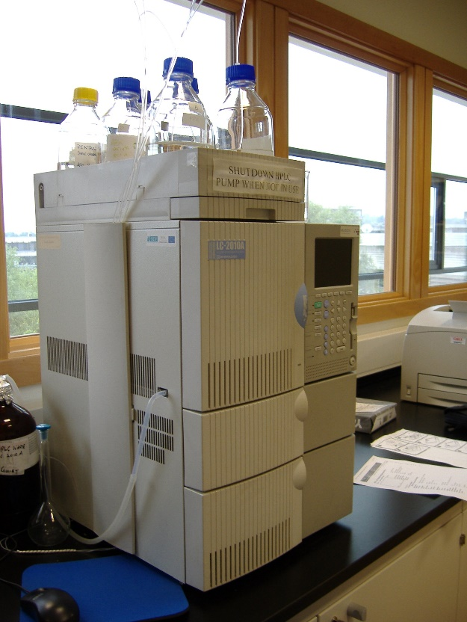
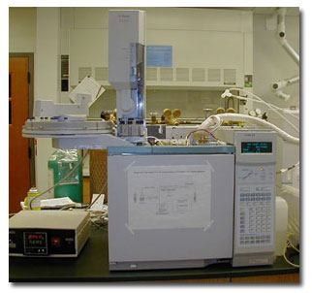
Types of chromatography
Thin layer
Paper
HPLC
Column
Gas

Slide 5
The basics of how it works
In all chromatographic separations, the sample is transported in a mobile phase. The mobile phase can be a gas, a liquid, or a supercritical fluid.
The mobile phase is then forced through a stationary phase held in a column or on a solid surface. The stationary phase needs to be something that does not react with the mobile phase or the sample.
The sample then has the opportunity to interact with the stationary phase as it moves past it. Samples that interact greatly, then appear to move more slowly. Samples that interact weakly, then appear to move more quickly. Because of this difference in rates, the samples can then be separated into their components.

Slide 6
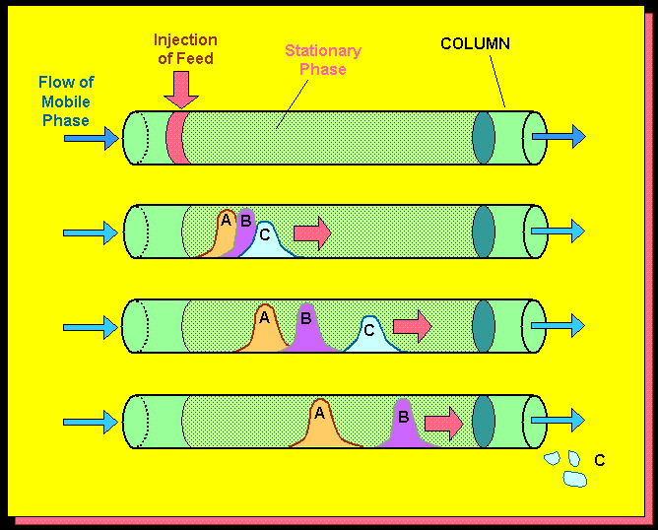
The basics of how it works
Sample placed at one end
Mobile phase flows through the system
Which compound is interacting the most with
The mobile phase?
The stationary phase?

Slide 7
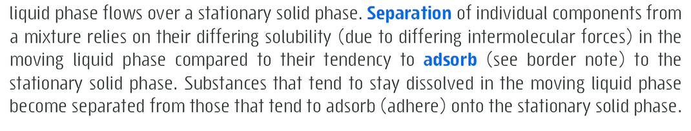
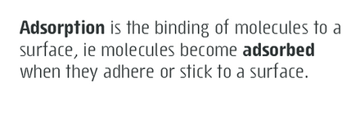
The basics of how it works
Your textbook definition (chapter 19.1 Essential Chemistry)

Slide 8
The basics of how it works
Many different types of chromatography
We change the mobile and stationary phase to separate compounds based on different physical properties:
Solubility
Boiling point
Particle size
Polarity
Charge

Slide 9
The basics of how it works
All chromatography involving a mobile phase (which moves) and a stationary phase (doesn’t move)
All types of chromatography need:
A way to introduce the sample
A way to control the rate at which the sample moves
Nature of the mobile phase
Nature of the stationary phase
A way to detect when samples are exiting
Different types of chromatography are used for different purposes and have different advantages and disadvantages.

Slide 10
Group work
Form 8 groups
Write your group name next to a topic on the whiteboard
Make a short presentation (powerpoint only) on your topic using only the textbook (you can add images from a google image search)
Each group will present their area to the class. All presentations will be placed on Onenote for everyone!
Chromatography topics:
Paper chromatography (ch 19.2)
Column chromatography (ch 19.3)
Thin layer chromatography (ch 19.4)
Gas chromatography (ch 19.6)
High performance liquid chromatography (ch 19.8)
Identifying analytes from retention time (ch 19.7)
Concentration analysis using HPLC (ch 19.9)
Applications of GC and HPLC analysis (ch 19.10)

